Slide 1
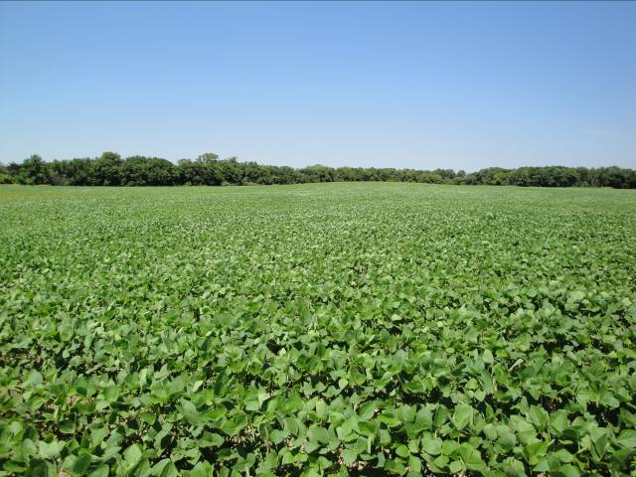
2020 Soybeans
Jeff Whitworth
Holly Davis
Kansas State University

Slide 2
Potential Pests of Soybeans
Below Ground/Seedling
Above Ground
White grubs
Wireworms
Pillbugs
Bean leaf beetle larvae
Indirect Pests:
Bean leaf beetles (BLB)
Grasshoppers
Green cloverworms
Garden webworms
Indirect Pests Cont:
Blister beetles
Spider mites
Soybean aphids
Dectes stem borer
Direct Pests:
Stink bugs
Corn earworms
Bean leaf beetles
Above Ground

Slide 3
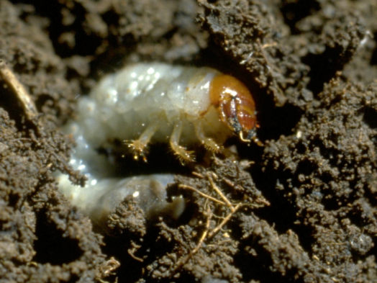
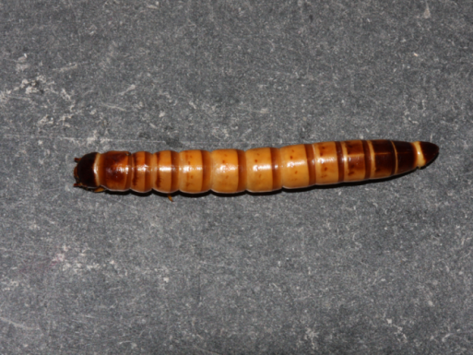
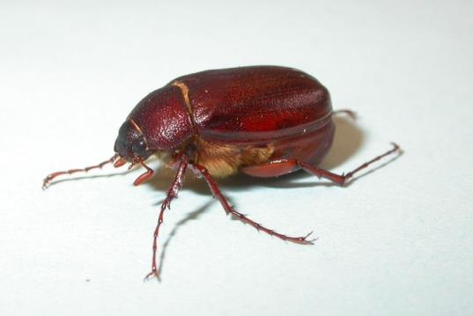
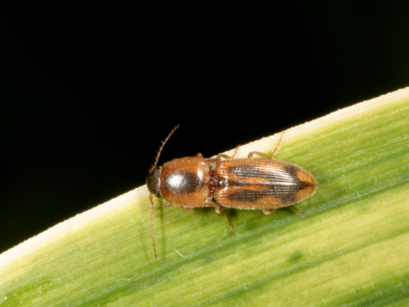
Early Season/Belowground Pests:
White Grub, Wireworm, BLB larvae
callagator.blogspot.com

Slide 4
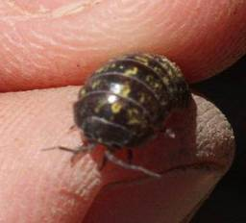
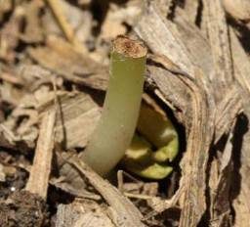
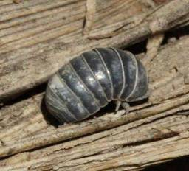
Pillbugs: Perennial problem in south central KS
Need moisture to survive
Thrive under no-till management
Photos by Brian McCornack

Slide 5
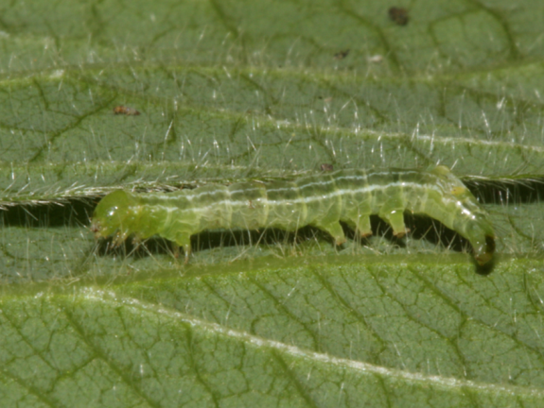
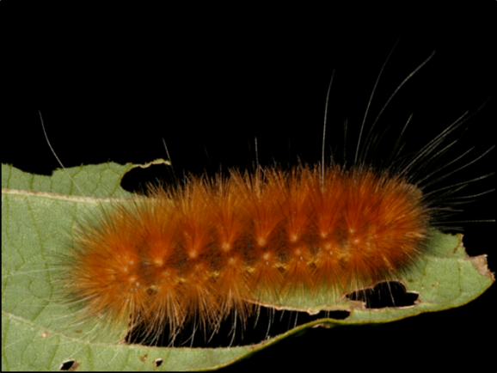
Defoliators = Indirect Pests
Not too manythe last 2 years in most parts of the state (2018/2019)
Plants tolerant in the vegetative stages and can withstand 40-60% defoliation with little negative impact on the plant

Slide 6
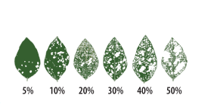
How much defoliation?
If defoliation approaches 20% in reproductive stages, treatment may be warranted if insects are actively feeding and defoliation is expected to increase.

Slide 7
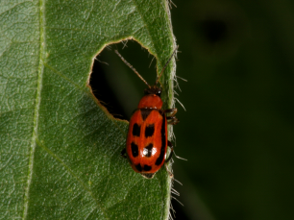
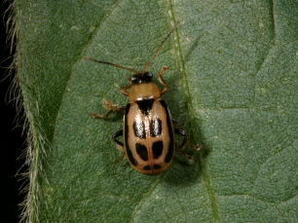
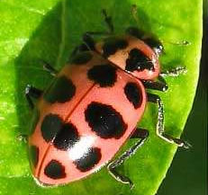
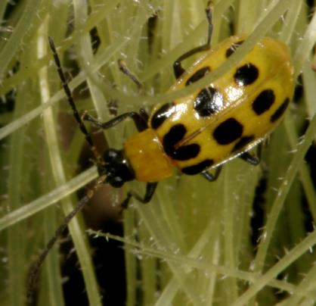
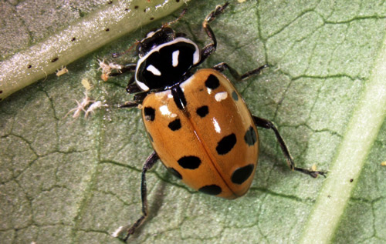
Bean Leaf Beetle - Identification
Tan to red – 2 color phases
6 black spots on wings
Black band on outside of wing cover
Black triangle behind head
Bean leaf beetles
Southern corn rootworm
Lady beetles

Slide 8
Bean Leaf Beetle
Two generations / year
Overwinter as adults under leaf litter
In early April (50 - 55°) adults begin feeding on weeds until beans emerge
Females lay eggs in soil around soybean stems
Larvae feed on soybean roots

Slide 9
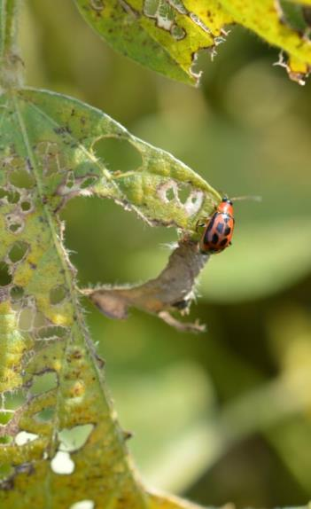
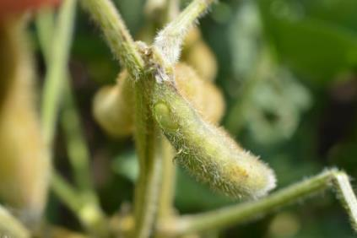
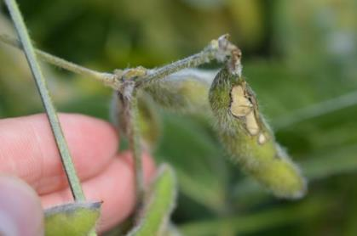
Bean Leaf Beetles
1st generation adults:
  Chewing oval holes between leaf veins
2nd generation adults:
  Pod feeding damage most important – may transmit bean mottle virus
New pics

Slide 10
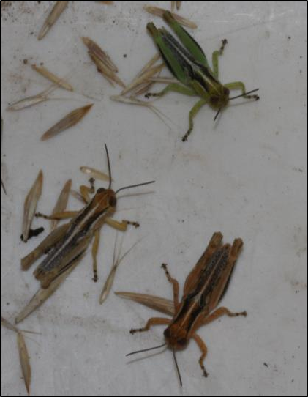
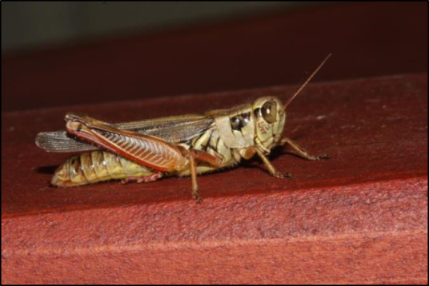
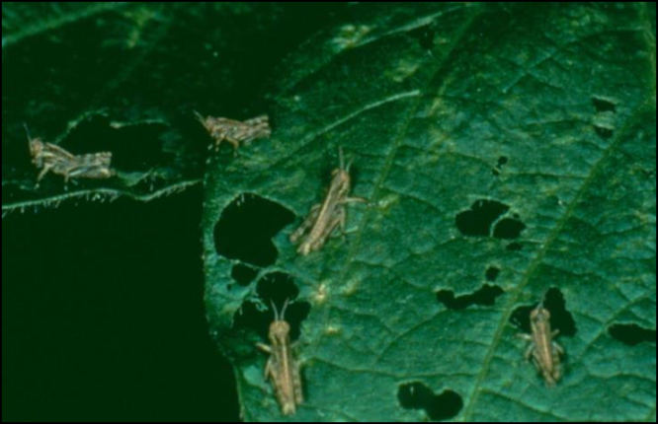
Grasshoppers
Scout borders in early summer to prevent migration into soybeans
15-20 nymphs / sq yd in borders or 5-8 nymphs / sq yd in field may justify treatment

Slide 11
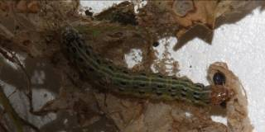
Garden Webworm
2-3 generations a year
Feed on wide range of host plants
Larvae skeletonize and web together foliage
Peak damage late July – August or early September

Slide 12
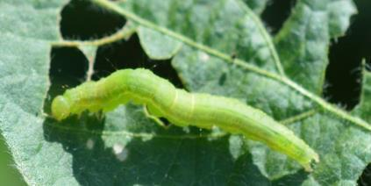
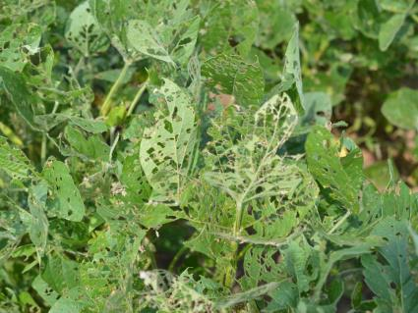
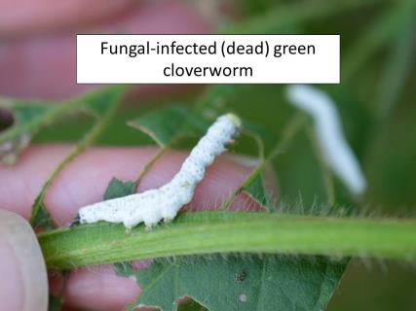
Green Cloverworms
Caused significant defoliation in 2016 & 2017
In 2016 controlled by an entomopathogenic fungus
Double cropped beans most likely to be impacted

Slide 13
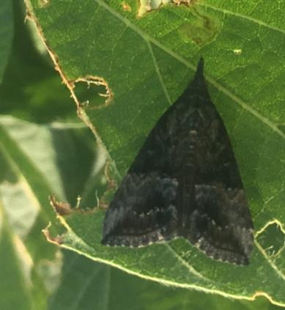
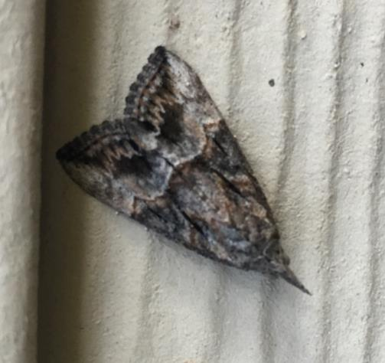
Green Cloverworm Adult
Do not overwinter in KS, large populations this year are not indicative of populations next year

Slide 14
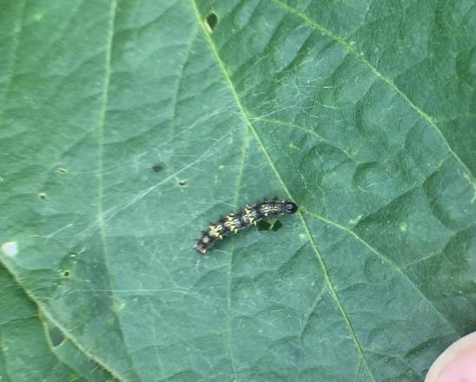
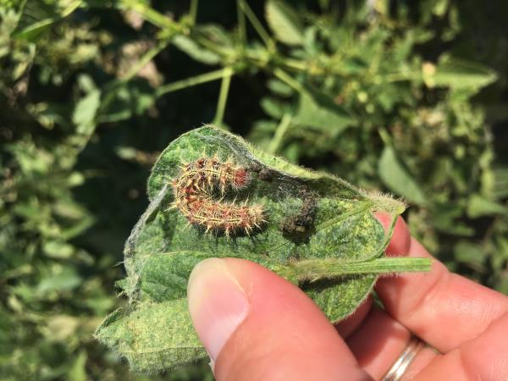
Thistle Caterpillar/Painted Lady
Early instar thistle caterpillar
Thistle caterpillar in “webbed leaf”
Large populations in 2017 and numerous in 2018 & 2019
May cause significant defoliation but typically only in localized areas

Slide 15
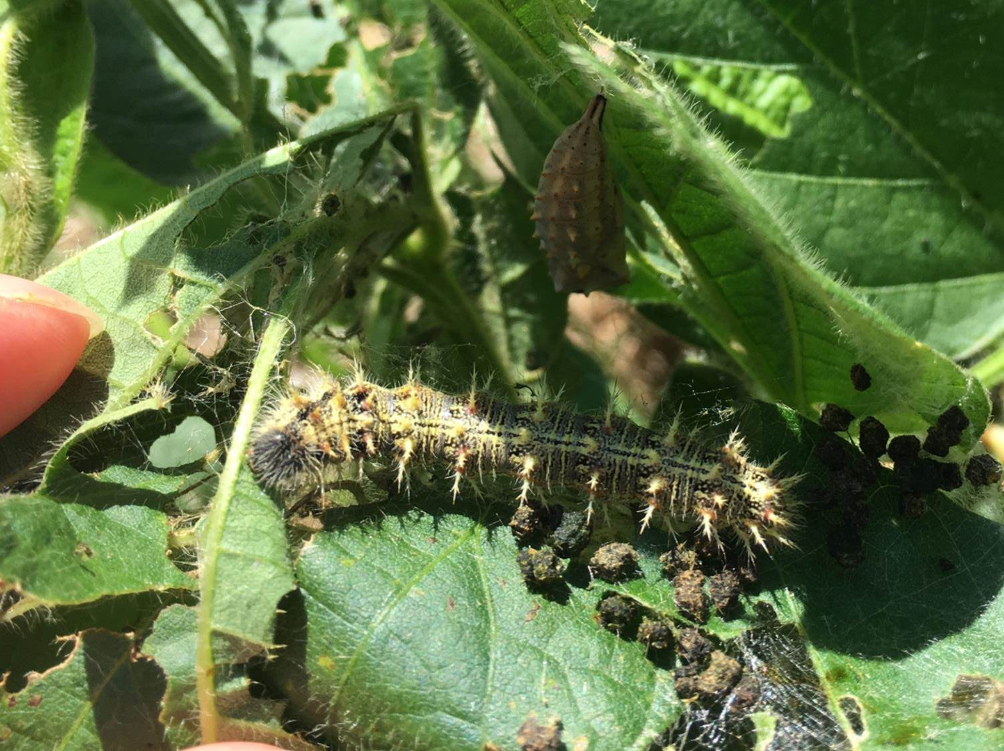
Mature Thistle Caterpillar and Chrysalis

Slide 16
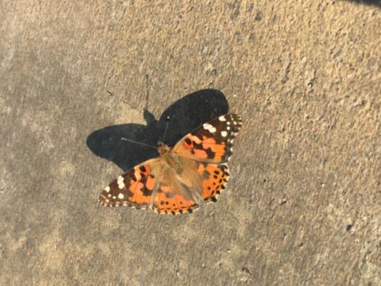
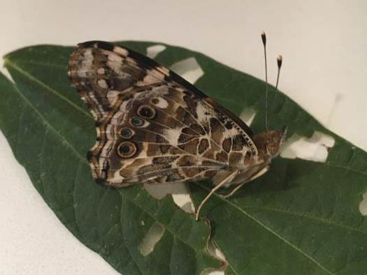
Thistle Caterpillar/Painted Lady
2 Complete generations in 2018/2019 with large numbers of adults emerging in early Oct.
Top view
Side view

Slide 17
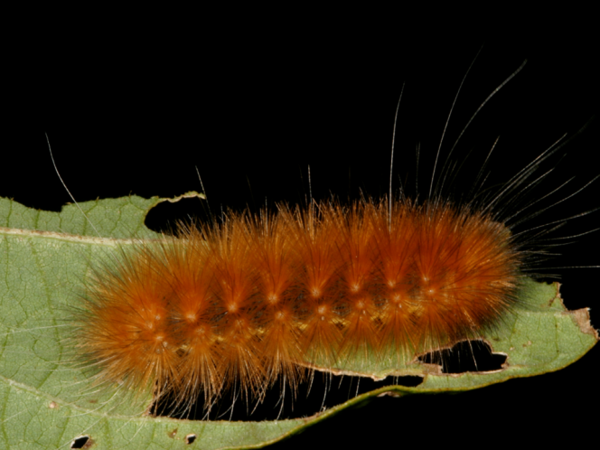
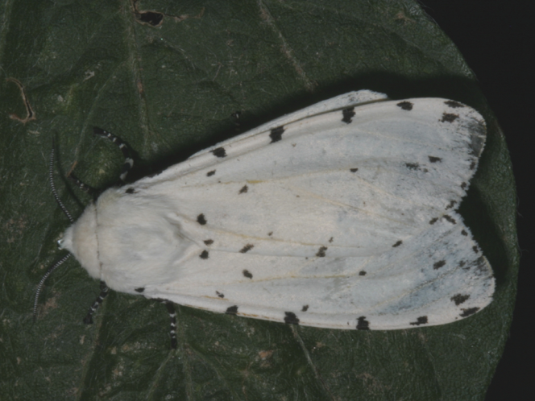
Yellow Woolly Bear
Larva
Adult

Slide 18
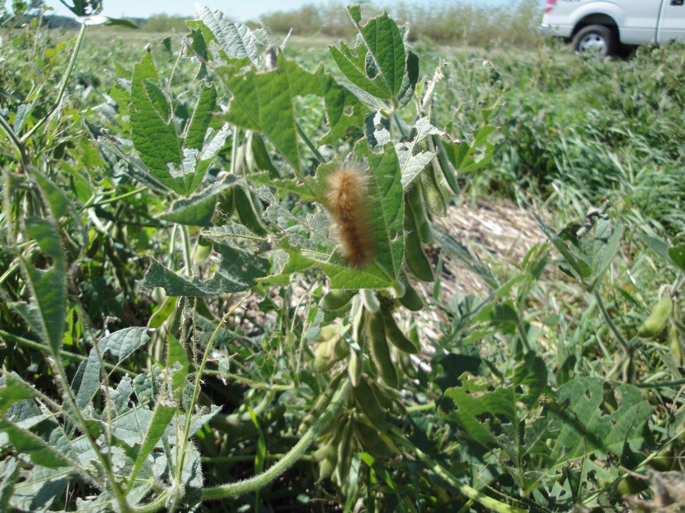

Slide 19
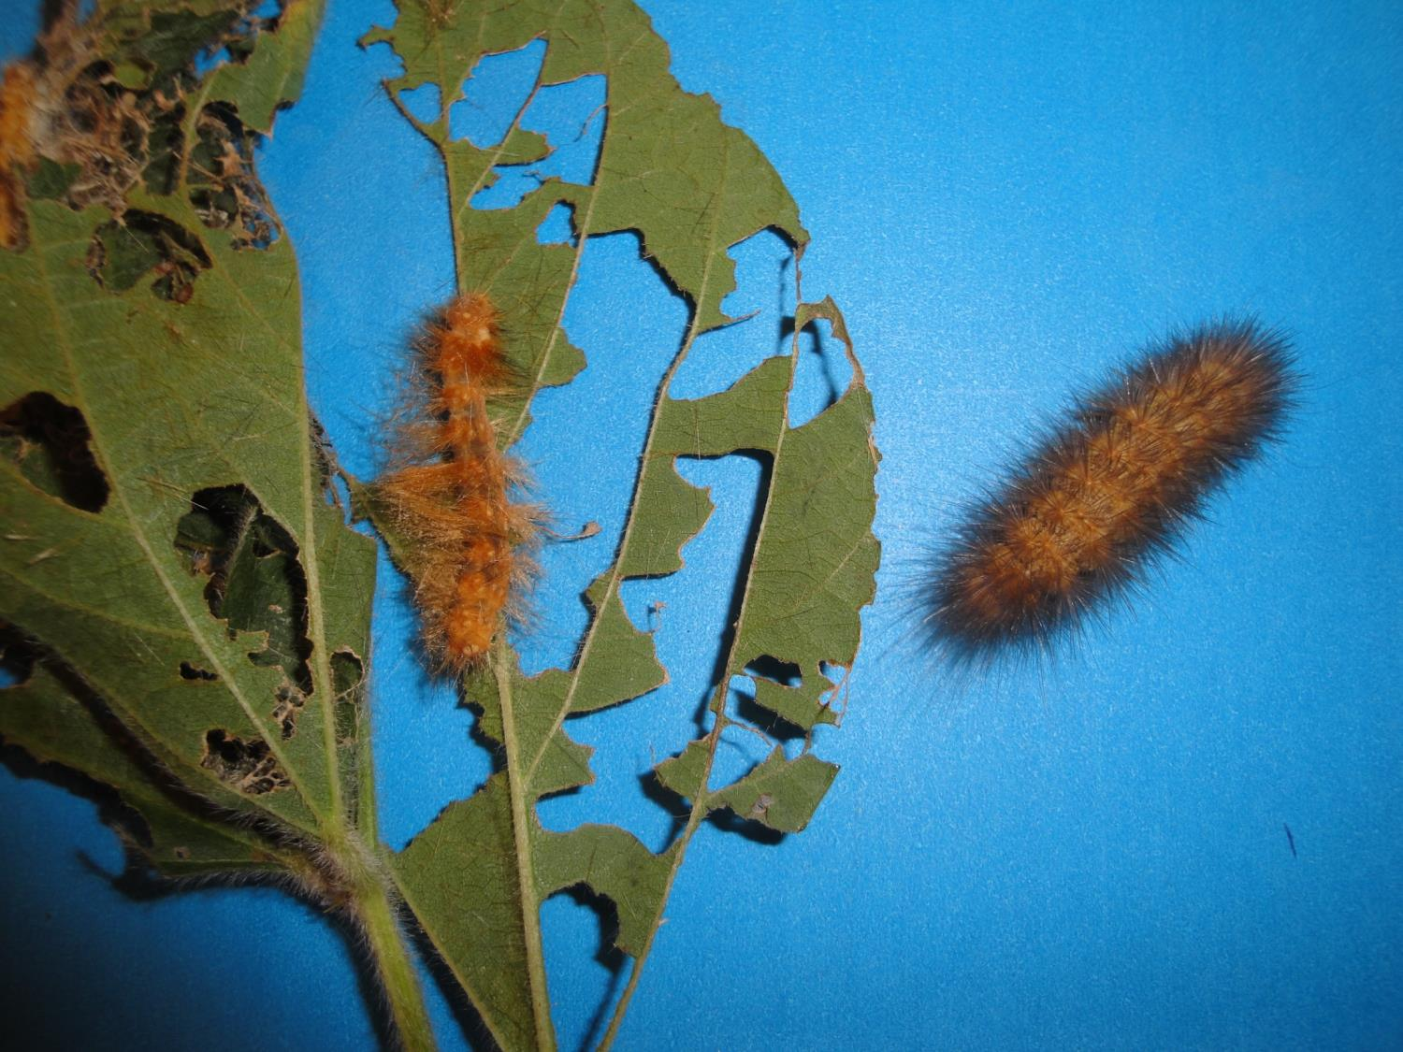
Diseased/Parasitized
Healthy

Slide 20
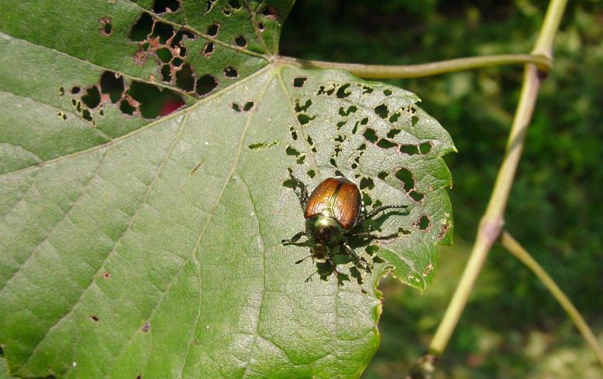
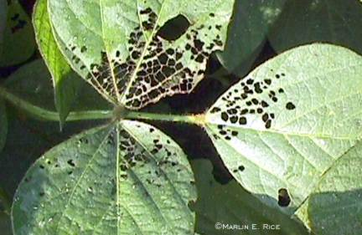
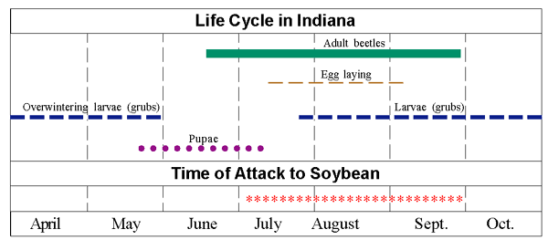
Japanese Beetle
extension.missouri.edu
Purdue University

Slide 21
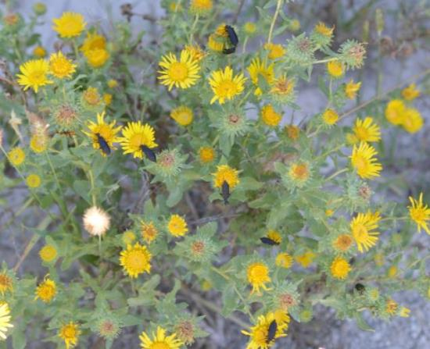
Blister Beetles
Lots of blister beetles around in 2018
Rarely needs treatment, however, 20% defoliation at pod fill may justify spot treatment
Notes:
Blister Beetle

Slide 22
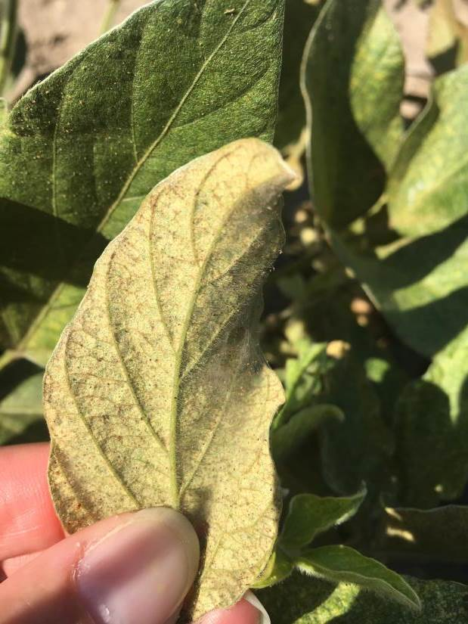
Spider Mites
May cause yellowing and premature leaf loss.
Loss of more than 50% of foliage during bloom and pod set may cause plants to stop blooming.
Field wide infestations in late bloom and early reproductive stages can cause 40-50% yield loss.

Slide 23
Mite Treatment Decisions
Infestations begin in spots, early treatment may prevent them from spreading throughout a field.
Strive to treat before foliage is extensively yellowed, if the field is still in the early reproductive stage of development.
Remember, insecticide treatments may allow mite populations to flare

Slide 24
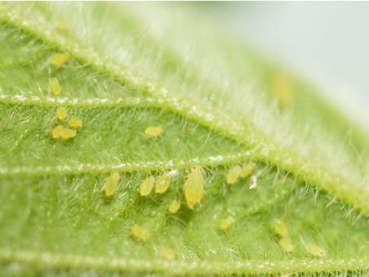
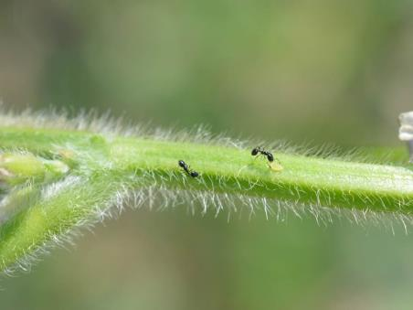
Soybean Aphids
Small, pale yellow with black cornicles (tailpipes)
Winged and Wingless forms
Usually colonize on underside of leaves initially but may start anywhere
Prefer cooler weather, 70 - 80°F
Currently the only aphid in North America that colonizes (infests and reproduces) on soybeans
Relatively common in NC KS in 2017 but none detected in 2018. Few detected in 2019 – no problems

Slide 25
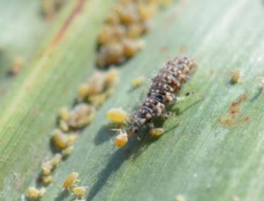
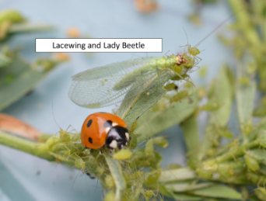
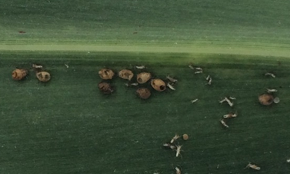
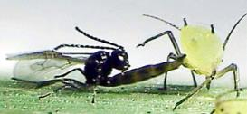
Aphid Control
Beneficial insects – May help limit aphid populations
Continued monitoring is necessary to determine impact

Slide 26
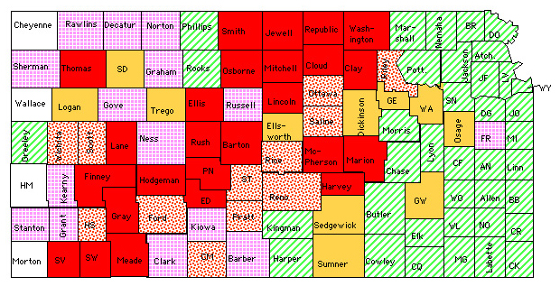
2008 Dectes Stem Borer Survey
50 % or more of plants infested
Known to have previous infestations
20 - 40 % of plants infested
NO infestations detected (sampled)
Low # of plants infested
NO infestations detected (not sampled)

Slide 27
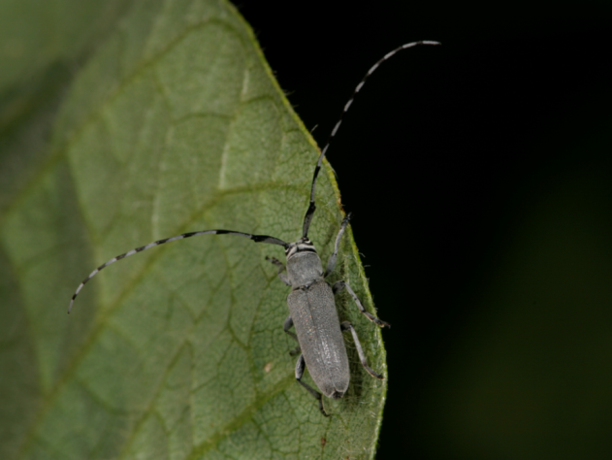

Dectes Stem Borer
Adults active July -August, very mobile
Found in sunflowers or soybeans
Lay eggs on leaf petioles
Larvae tunnel down the petioles and into the stem
Tunneling within petiole causes the leaf to wilt and die

Slide 28


Dectes Stem Borer
Larvae tunnel into the stem where they are inaccessible to insecticides
Tunnel down the plant to below the surface by fall

Slide 29


Dectes Stem Borer
Girdled plant (over-wintering site)
Girdling usually occurs just before harvest
Causing the plant to fall over thus lost to harvest
Larvae overwinter in stalk just below the surface of the ground

Slide 30
Dectes Stem Borer Management
Adults active for 8+ weeks so multiple insecticide applications needed
Larvae protected in stem
Plant resistance has been found but will not be commercially available for some time
HARVEST EARLY!

Slide 31

Soybean Gall Midge
Still have a lot to learn about this pest, including what species it is
Cultural control practices do not impact midge (variety selection, planting time, tillage practices, etc.)
Insecticide seed treatments do not appear effective
No confirmed reports in KS yet.
iastate.edu

Slide 32

Direct Pest = Feed directly on the pods/seeds

Slide 33



Stink Bugs

Slide 34

Stink bug damage
Control may be necessary when average
1 bug/3 row ft.

Slide 35



Stink Bugs
Brown Stink Bug

Slide 36


Corn Earworm / Soybean Podworm
Doug Shoup

Slide 37
Corn Earworm / Soybean Podworms on Soybeans
Treatment Threshold:
Where worm counts average 1 worm/row foot
On a shaker cloth – usually sample about 3 ft of row – so 3 worms/site = treatment threshold
Note: Consider only small worms.
Those not larger than 1/2” long.

Slide 38

Soybean Podworm
Concerns about resistance to insecticides
300 worms collected from untreated soybean field and utilized for resistance assay
Evaluated 24 hours later:
Treatment | % of Larvae Live | % of Larvae Moribund | % of Larvae Dead
Hero @ 6 oz/a | 0 | 3.4 | 96.6
Lorsban @ 2 pts/a | 0 | 8.6 | 91.4
Mustang Maxx @ 4 oz/a | 0 | 10.9 | 89.1
Baythroid @ 2.8 oz/a | 0 | 15.5 | 84.5
Warrior II @ 1.6 oz/a | 0 | 3.4 | 96.6
Untreated | 87.5 | 9.4 | 3.1 (parasitized)

Slide 39

Bean Leaf Beetles
2nd generation feed on pods – of most economic importance
Feed directly on pod
May transmit bean pod mottle virus
If feeding results in loss of 3 or more seeds per plant – treatment may be justified
Notes:
Bean leaf beetle (red phase) and feeding damage

Slide 40

Visit: http://entomology.k-state.edu/extension/

Slide 41


Books:
Identification guides
Biology
Damage/ Thresholds
Management options
Available from the KSRE Bookstore: https://www.bookstore.ksre.ksu.edu/

Slide 42

For more info, please visit: http://entomology.k-state.edu/extension/
Thank you!
Questions?
Jeff Whitworth
jwhitwor@ksu.edu

Slide 43


Soybean Gall Midge
2018 - Nebraska, Iowa and S. Dakota (66 counties)
Large portions of plants dying from field margins inward
Impacted plants have dark discoloration at soil surface up to the unifoliate node
Cropwatch.unl.edu
Cropwatch.unl.edu

Slide 44

Soybean Gall Midge
Upon closer investigation, stems snap of easily at the soil surface
White to orange larvae feeding on darkened areas of plants
Infested plants may have swollen stems near soil surface/feeding larvae
Cropwatch.unl.edu

